Slide 1
GRADIENTS
ALL
ABOUT

Slide 2
What is a Gradient?
2 Colors Minimum
A gradient fill is a shape fill that gradually changes from one color to another across the surface of the shape.
10 Colors Maximum

Slide 3
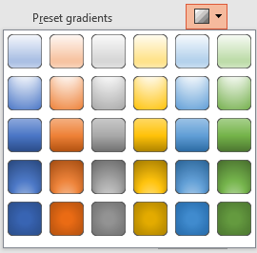
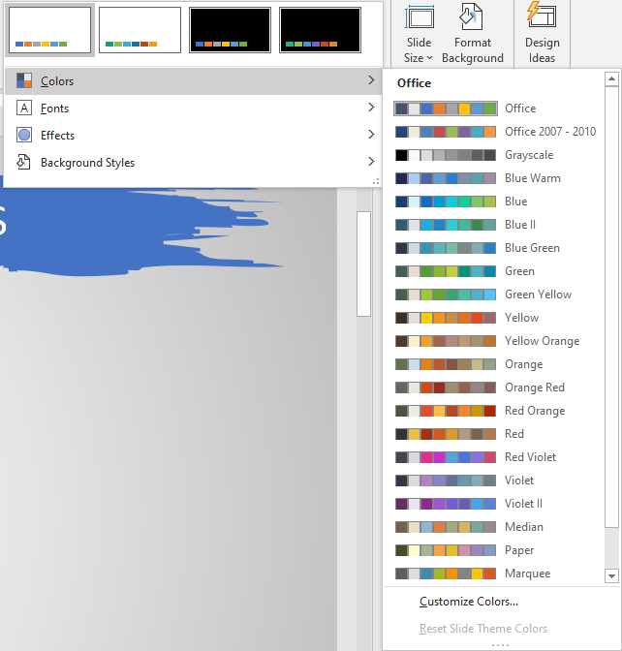
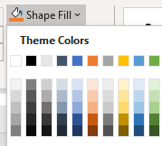
Preset Gradient Options
Light Gradient Accent 1
Light Gradient Accent 2
Light Gradient Accent 3
Light Gradient Accent 4
Light Gradient Accent 5
Light Gradient Accent 6
4 color default
Impacted by Design Variant Options & Theme Colors
Top Spotlight Accent 1
Top Spotlight Accent 2
Top Spotlight Accent 3
Top Spotlight Accent 4
Top Spotlight Accent 5
Top Spotlight Accent 6
Medium Gradient Accent 1
Medium Gradient Accent 2
Medium Gradient Accent 3
Medium Gradient Accent 4
Medium Gradient Accent 5
Medium Gradient Accent 6
3 color default
Bottom Spotlight Accent 1
Bottom Spotlight Accent 2
Bottom Spotlight Accent 3
Bottom Spotlight Accent 4
Bottom Spotlight Accent 5
Bottom Spotlight Accent 6
Dark Gradient Accent 1
Dark Gradient Accent 2
Dark Gradient Accent 3
Dark Gradient Accent 4
Dark Gradient Accent 5
Dark Gradient Accent 6
4 color default

Slide 4
Gradient Types & Directions
45°
TL-BR
90° Down
135°
TR-BL
0° Right
180°
Left
315°
BL-TR
270°
Up
90°
BR-TL
Linear
From Bottom Right Corner
From Bottom Left Corner
From Center
From Top Right Corner
From Top Left Corner
Radial
From Bottom Right Corner
From Bottom Left Corner
From Center
From Top Right Corner
From Top Left Corner
Rectangular
Path

Slide 5
This is a default title
Format Background Gradient
This is a default text body

Slide 6
Make Your Own Gradient - Metallic
White 5%
White 35%
White 5%
White 5%
White 35%
White 5%
6 gradient stops
4 light & 2 dark variations of the same color
White 5%
White 35%
White 5%
White 5%
White 35%
White 5%

Slide 7
Make Your Own Gradients – Playground!
Gradient applied to TEXT, not shape
Gradient applied to SHAPE, not text
Flip Flop the Gradient Stops!
Finding the Middle Ground

